Slide 1


CAR SALE ANALYSIS
USING SQL

Slide 2



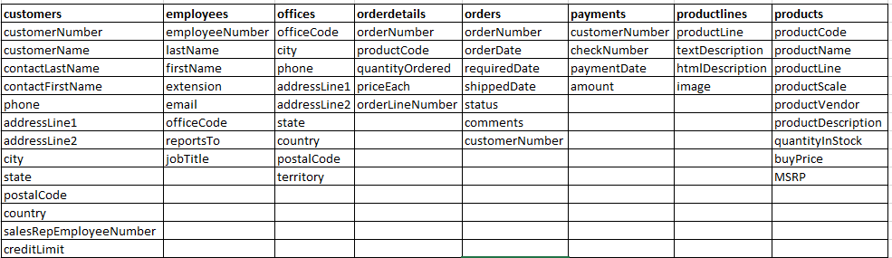
Show All Tables
Show Tables;

Slide 3
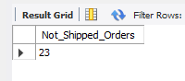
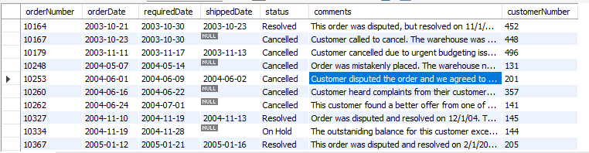
Retrive all data where order not shipped and also show number of orders number shipped
Select count(*) as “Not_Shipped_Orders” from orderswhere status != "Shipped";
select * from orderswhere status <> "Shipped";

Slide 4
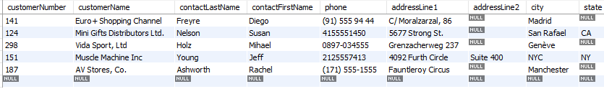
Find out top 5 customer who have highest credit limit
select * from customers order by creditLimit desc limit 5;

Slide 5
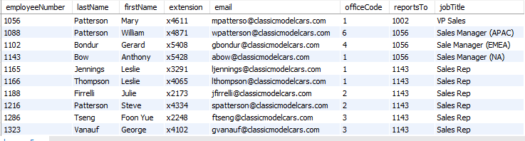
Retrive all employees where jobtitle contain word "sale"
select * from employees where jobTitle regexp "sale";

Slide 6
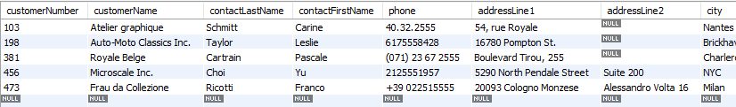
Retrive all customers where creditlimit between 20000 and 40000
select * from customers where creditLimit between 20000 and 40000;

Slide 7
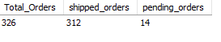
Display total order, shipped and pending orders
select count(requiredDate) as Total_Orders,
count(shippedDate) as shipped_orders,
( count(requiredDate) - count(shippedDate)) as pending_orders
from Orders;

Slide 8
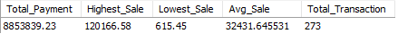
Dispaly total order, highest, lowest, avg sale and total payment
select sum(amount) as Total_Payment,
max(amount) as Highest_Sale,
min(amount) as Lowest_Sale,
avg(amount) as Avg_Sale,
count(amount) as Total_Transaction
from payments;

Slide 9
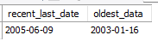
Find first day order and last day order
select max(paymentDate) as recent_last_date,
min(paymentDate) as oldest_data
from payments;

Slide 10
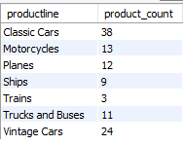
Find No of products in each product line
SELECT productline,count(*) as product_count
from products
group by productline;

Slide 11
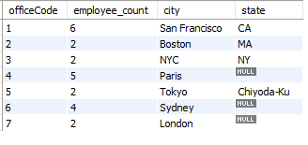
Count of employees, display office code, location that work in the same office
select officeCode,
count(employeeNumber) as employee_count, city,state
from employees join offices using (officeCode)
group by officeCode;

Slide 12
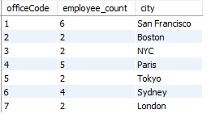
Which office have more than 4 employees
select officeCode,
count(employeeNumber) as employee_count, city
from employees join offices using (officeCode)
group by officeCode
having employee_count ;

Slide 13
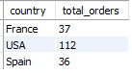
country wise no of orders, display total order count > 20
select country,count(orderNumber) as total_orders from orders
join customers using (customerNumber)
group by country
having total_orders > 20;

Slide 14
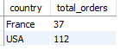
Show only orders of country - "France","Japan", "Finland","USA"
select country,count(*) as total_orders from orders
join customers using (customerNumber)
where country in ("France","Japan", "Finland","USA")
group by country
having total_orders > 20;

Slide 15
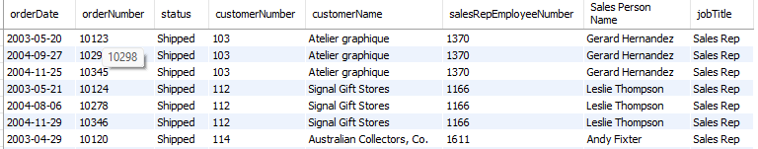
Find the customername and sales representative number from customer table
and representative name from employees tables
select orderDate, orderNumber, status, o.customerNumber,c.customerName, c.salesRepEmployeeNumber, concat(firstName," ", lastName) as "Sales Person Name", e.jobTitle
from orders o join customers c
on o.customerNumber = c.customerNumber
join employees e on c.salesRepEmployeeNumber =e.employeeNumber
order by "Sales Person Name";

Slide 16
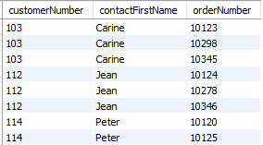
What orders have placed by each customer?
don't include those customer who have not placed any orders
select c.customerNumber,contactFirstName,o.orderNumber
from customers as c
left join orders as o
on c.customerNumber = o.customerNumber;

Slide 17
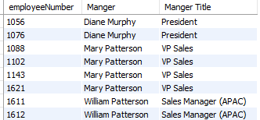
Find manger of each employees
select emp.employeeNumber,
concat(mgr.firstName," ",mgr.lastName) as "Manger",
mgr.jobTitle as "Manger Title"
from employees as emp
join employees mgr on emp.reportsTo = mgr.employeeNumber;

Slide 18
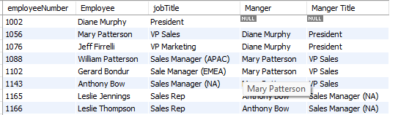
Retrive all employee number,employee name, jobtitle,
thier manger and manger name
select emp.employeeNumber, concat(emp.firstName," ",emp.lastName) as "Employee",
emp.jobTitle, concat(mgr.firstName," ",mgr.lastName) as "Manger",
mgr.jobTitle as "Manger Title"
from employees as emp left join employees mgr on emp.reportsTo = mgr.employeeNumber;

Slide 19
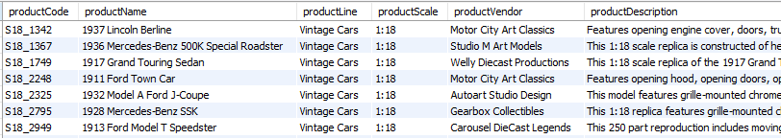
Find products that have same product line as of "1917 Grand Touring Seadan"
select * from products
where productLine =
(select productLine from products
where productName = "1917 Grand Touring Sedan");

Slide 20
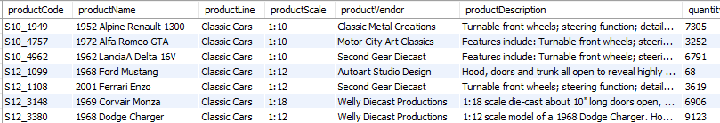
Find cars that are costlier than "1936 Mercedes-Benz 500K Special Roadster".
select * from products
where productLine regexp "Cars" and MSRP > (select MSRP from products
where productName = "1936 Mercedes-Benz 500K Special Roadster");

Slide 21
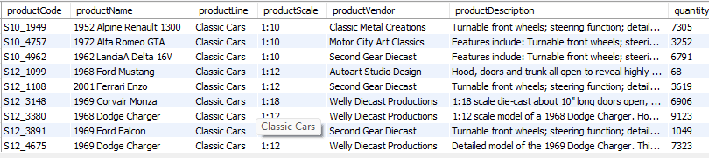
Find the cars that are costlier than average cost of all cars
select * from products
where productLine regexp "Cars" and MSRP > (select avg(MSRP) from products
where productLine in ("Classic Cars","Vintage Cars") );

Slide 22
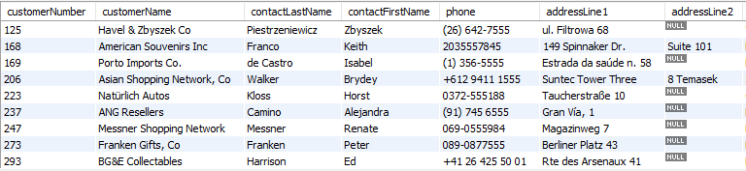
Customer who has never placed an orders (Using subqueries)
select customerNumber from customers
where customerNumber not in (select distinct customerNumber from orders);

Slide 23
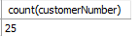
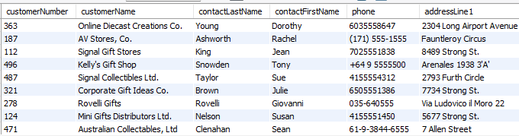
customer who ordered the product with product code "S18_1749"
select * from customers
where customerNumber in (select customerNumber from orderdetails
join orders using (orderNumber)
where productCode = "S18_1749" );

Slide 24
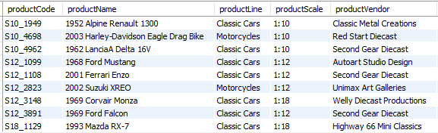
Find products costlier than all trucks
select * from products
where MSRP > (
select max(MSRP) from products
where productLine regexp "truck");

Slide 25
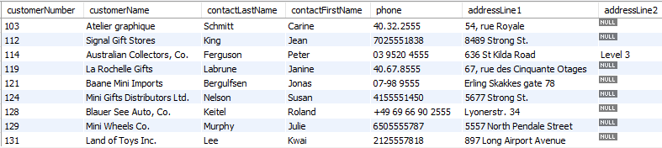
Find all clients who has made atleast two payments
select * from customers
where customerNumber in (
select customerNumber from payments
group by customerNumber
having count(amount) >= 2);

Slide 26
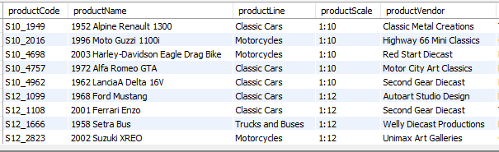
Find products whose price higher than average MSRP in their corrosponding line
select * from products p
where MSRP > (
select avg(MSRP) from products
where productLine = p.productLine);

Slide 27
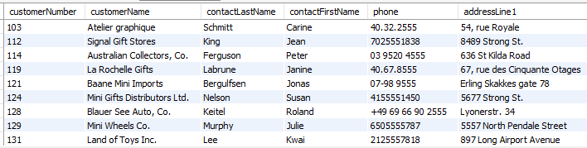
Find customer who made any payment usning exist clause
select * from customers c
where exists (
select customerNumber
from payments
where customerNumber=c.customerNumber);

Slide 28
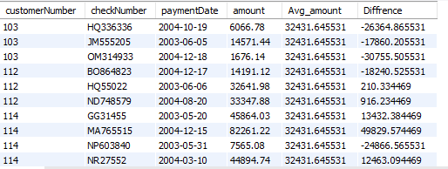
Write a query create the following "view" of payment table
select *, (select avg(amount) from payments) as Avg_amount,
amount - (select avg_amount) as Diffrence
from payments;

Slide 29
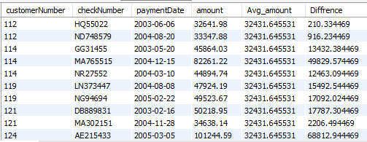
write a query create the following "view" of payment table
where differnce > 0 (amount is higher than average)
select * from
(select *, (select avg(amount) from payments) as Avg_amount,
amount - (select avg_amount) as Diffrence from payments) as pay
where Diffrence > 0;

Slide 30
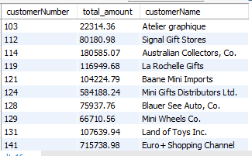
Total payment from each customer after a certain date
select customerNumber,sum(amount) as total_amount, customerName
from payments join customers using (customerNumber)
where paymentDate > "2002-02-02"
group by customerNumber
order by customerNumber, customerName ;

Slide 31
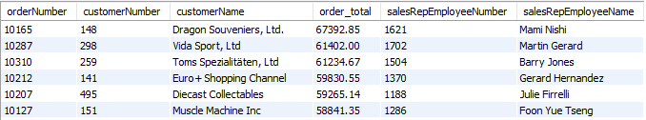
value of each unique order and it's customer name and
sales employees sorted by total order values
select orderNumber,customerNumber,customerName,
sum(quantityOrdered*priceEach) as order_total, salesRepEmployeeNumber,
concat(emp.firstName," ",emp.lastName) as salesRepEmployeeName
from orderdetails
join orders using (orderNumber)
join customers using (customerNumber)
join employees as emp on (salesRepEmployeeNumber = employeeNumber)
group by orderNumber
order by order_total desc;

Slide 32
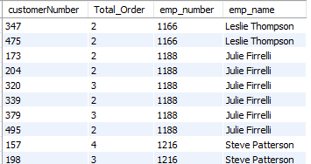
Number of orders placed by each customers
and sales employee of that customer.
select customerNumber,count(*) as Total_Order,
salesRepEmployeeNumber as emp_number, concat(firstName," ",lastName) as emp_name
from orders
join customers using(customerNumber)
join employees on ( salesRepEmployeeNumber = employeeNumber)
group by customerNumber;

Slide 33
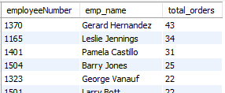
Number of orders Through each sales employee/Representive
select employeeNumber, concat(firstName," ",lastName) as emp_name, count(orderNumber) as total_orders
from orders
join customers using (customerNumber)
join employees on ( salesRepEmployeeNumber = employeeNumber)
group by employeeNumber
order by total_orders desc;

Slide 34
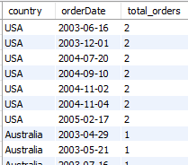
Number of orders country wise
select country,orderDate,count(*) as total_orders from orders
join customers using (customerNumber)
group by country,orderDate
order by country,orderDate;

Slide 35
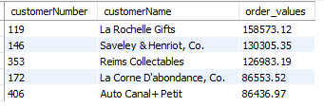
find the customers from france
whose total orders values > 80,000 across all thier orders
select customerNumber,customerName,sum(quantityOrdered*priceEach) as order_values from customers
join orders using (customerNumber)
join orderdetails using (orderNumber)
where country = "France"
group by customerNumber,customerName
having order_values> 80000
order by order_values desc;

Slide 36
find the customers from france
whose total orders values > 80,000 across all thier orders
select customerNumber,customerName,sum(quantityOrdered*priceEach) as order_values from customers
join orders using (customerNumber)
join orderdetails using (orderNumber)
where country = "France"
group by customerNumber,customerName
having order_values> 80000
order by order_values desc;

Slide 37

THANK YOU
PRESENTED BY NISHANT

